Slide 1


S4D400 - Introduction to abap programming on s/4hana
Anubhav Oberoy

Slide 2

Agenda – Day 5
Using Interfaces
- What is an Interface
- Why Interface
- Creating Interfaces and Type casting
- Map objects to Interfaces
- Create program using interface
- Debugging
---break--
[Optional]
- Introduction to CDS Views
- Create basic CDS Views
- Introduction to Fiori
- Create OData Service
- Build simple Fiori App on WebIDE on S/4HANA
- Debugging of Fiori Apps
QnA Session

Slide 3
Abstract Class
An abstract class is a class
Which can not be instantiated.
Which contains at least one abstract method.
We use them in case the implementation of at least one method is not known. This allows both reuse and accidently avoidable class object creation.

Slide 4
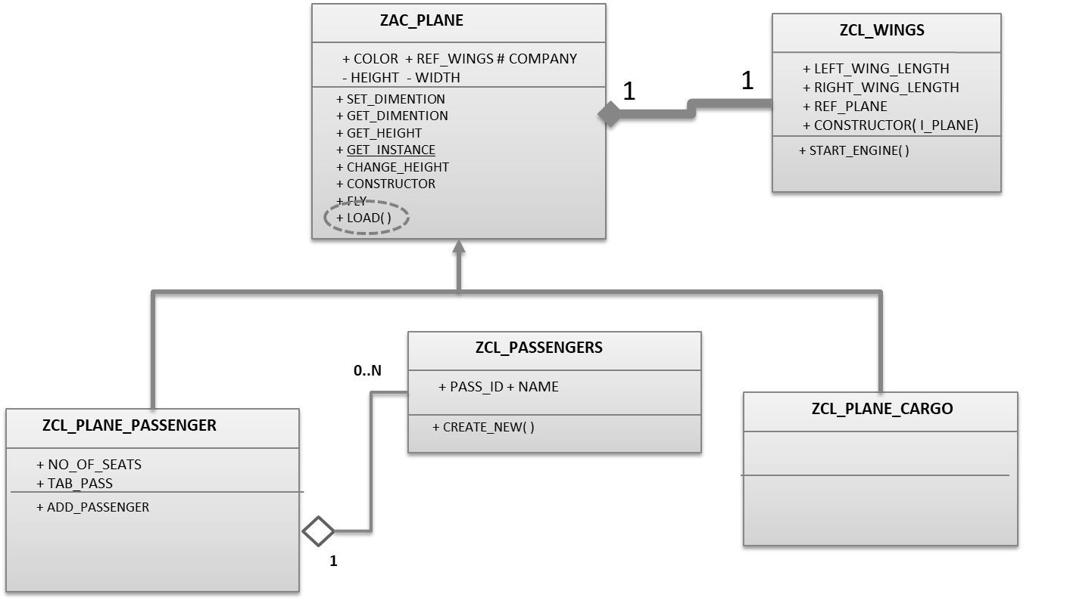
Exercise Abstract Class
Implement a new Abstract class
ZAC_XX_PLANE
and include load() function as abstract

Slide 5
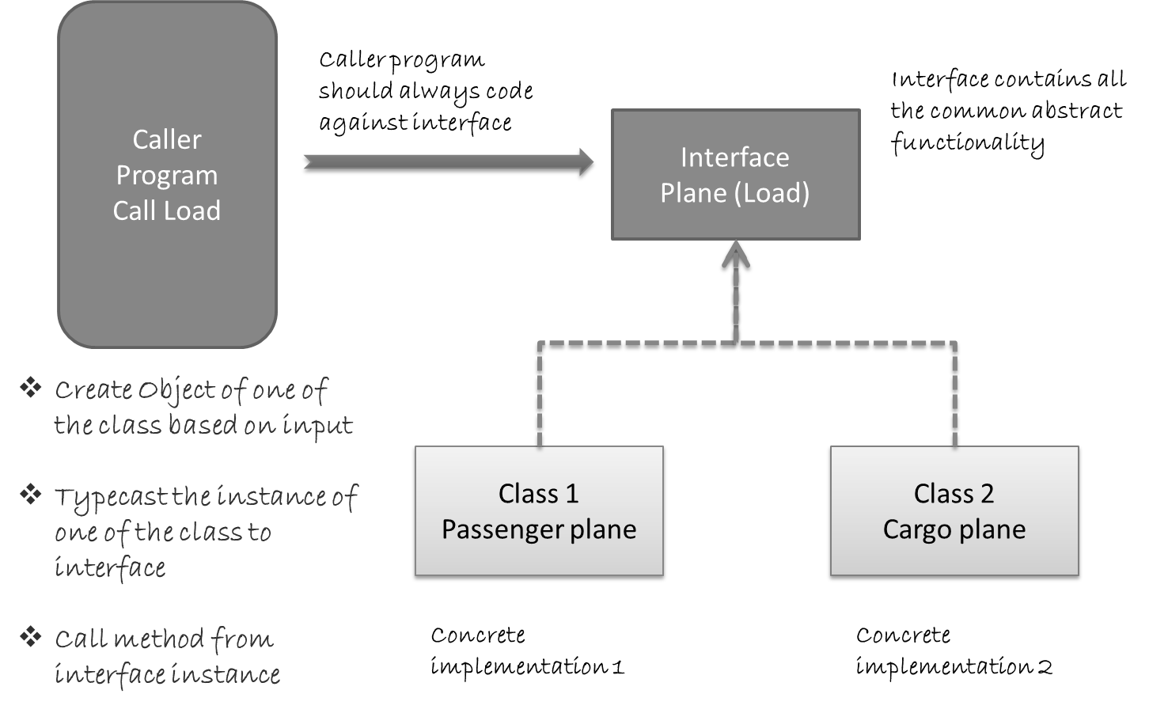
Interface
An Interface is a pure abstract class and will allows developer to extend application swiftly. It overcomes the disadvantage of call to method for multiple implementation and enables run-time polymorphism.

Slide 6
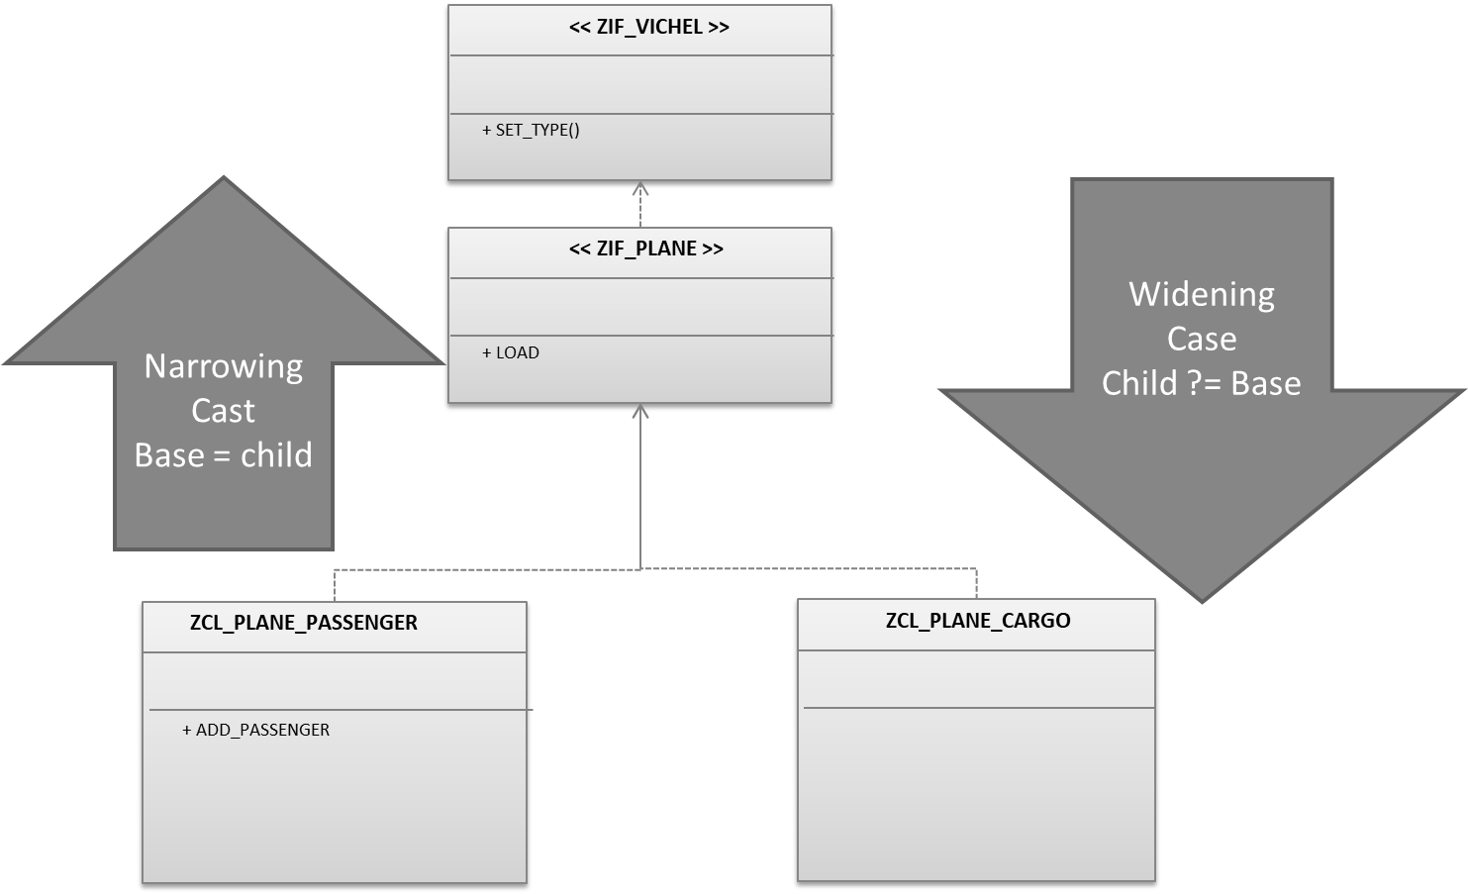
Type Casting

Slide 7
Exercise - Interface
Create an Interface ZIF_XX_PLANE
Inherit the interface in Base class
Enhance report to handle interface

Slide 8
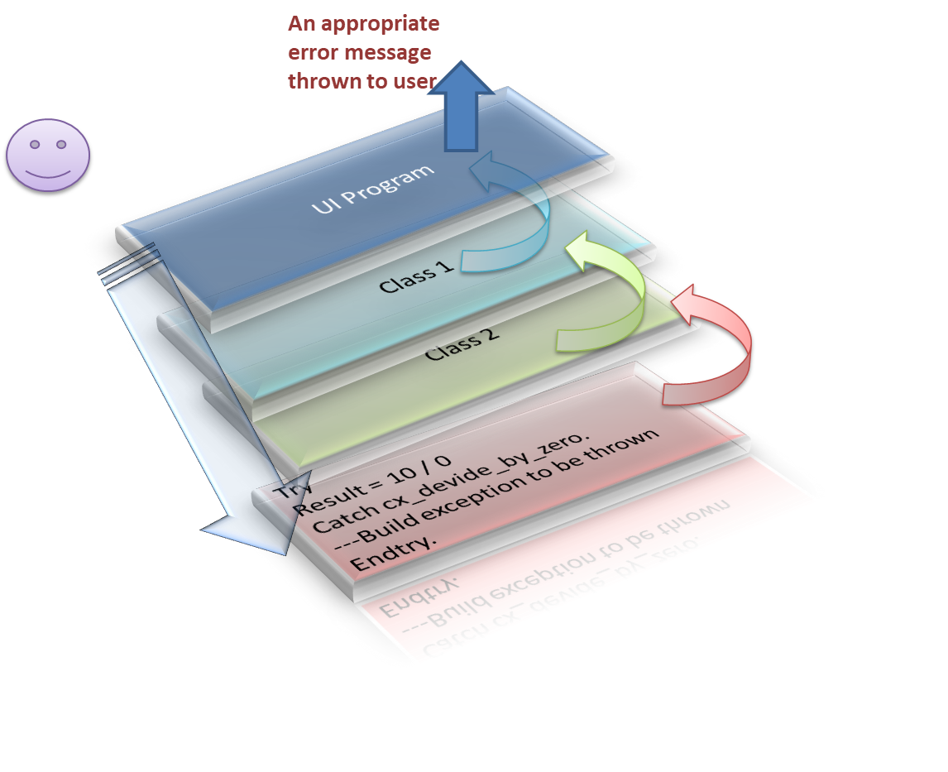
Exception Handling
The occurrence of an exception is normally used to display an error situation. The handler of an exception must try to correct the error that has occurred, find an alternative solution, or (if this is not possible) at least bring the affected context into a consistent state and then forward the error.
If a call hierarchy does not contain a handler for an exception, the program is ended with a runtime error. Since exceptions cannot be handled by means of program calls, all possible exceptions within the program itself must be handled to prevent a runtime error. This rule does not apply to the coding within procedures whose exceptions can easily be propagated to (external) callers.
Cascading exception
An exception has been thrown in a method of a class.
This method was called by other class which intern called by other class followed by UI program

Slide 9
Steps in Exception Handling
Create an exception class and inherit call CX_STATIC_CHECK (Root class for OOABAP exception handling).
Go to method where you would like to build and throw exception, Add the exception class name in exception section of method signature.
TRY…CATCH the exception in the method and create object of your exception class.
Add additional information like message class to exception object and use RAISE EXCEPTION method to throw the exception.
Once exception is thrown, Catch the exception by declaring object of same class in caller program.
In case if the exception has to propagated to above layer, add the same class to all the callers.
Syntax
Declaration of object
Data : lo_ex_object TYPE REF TO cx_excep_class_name.
Preparation of object
CREATE OBJECT lo_ex_object.
lo_ex_object->messages = lt_local_messages.
Throwing the exception
RAISE EXCEPTION lo_ex_object.
Catching the exception
CATCH cx_excep_class_name INTO lo_ex_object.

Slide 10
Exercise – Exception Handling
Create a new Exception handling class CX_XX_EXCEPTION_FLY
Check if the fuel tank is less than 5 gallon
Throw a NOT FLY Exception

Slide 11

Break

Slide 12
ABAP on Eclipse Tool

Slide 13
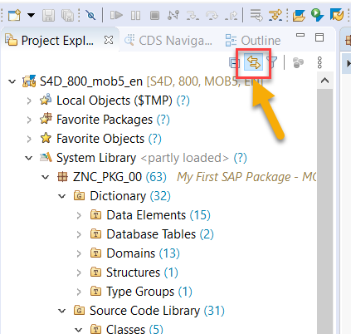
Create new ABAP Project (An ABAP Project is just a connection to an SAP system)
Select your system
Say next and provide your user and password, client is 800
System will be added on left side
Use keyboard shortcut Ctrl+Shift+A
Search for your package ZNC_PKG_XX
Select your package and choose the link to editor button
Now we can see our package just like SE80 and open any program
Open last class program and press F8 to execute
You can test your ABAP program now in eclipse.

Slide 14
Introduction to CDS View
CDS stands for Core Data & Services, It is an enhancement of SQL in ABAP. CDS is also known as semantically-rich data model. @ annotations – auto generate code for you

Slide 15
Exercise – Simple CDS View
Create a simple CDS View with name ZNC_XX_CDS_VIEW
Right click on package, choose new Other ABAP Object..
Search Core Data and select Data Definition
Click Next and provide view name ZNC_XX_MY_CDS
Click Next and choose transport
Click Next and Select template as Define View
Click Finish

Slide 16
Introduction to OData
<content>

Slide 17
Exercise – Create OData Using CDS
<content>

Slide 18
Introduction to SAP Fiori App
<content>

Slide 19
Where to check all Fiori Apps?
https://fioriappslibrary.hana.ondemand.com/sap/fix/externalViewer/#

Slide 20
WebIDE tool
<content>

Slide 21
Create Simple Fiori App
<content>

Slide 22
Exercise – Fiori App Development
<content>

Slide 23
Field Extension

Slide 24
End of Day 5

Slide 25

Questions

Slide 26

Anubhav Oberoy

